Slide 1
Fingerprint identification and fingerprint based gender recognition
Arwa Arif(201230016)
Urvashi Senha(201225020)
G Drushti Apoorva(201225011)

Slide 2
abstract
Fingerprints are considered to be valid evidences in law courts all over and hence any breakthrough in fingerprint matching would be highly useful. There have been studies to develop an intelligent automatic fingerprint identification and verification system using feature extraction via image processing and classification via ANNs.

Slide 3
Problem statement
We need to implement a system that identified fingerprints using physical features from fingerprint images and classifying them.
Our approach involved minutiae extraction, after which we used an alignment-based elastic matching algorithm.
Also, we extended our project with efforts towards fingerprint-based gender classification.

Slide 4
Dataset used
Images of fingerprints that are classified according to gender. It includes 10 fingerprints each for males as well as females. We have used 145 images each of male and female for training purposes. We have tested the system over 100 images each for male and female.
Dataset can be found at: http://www.unilorin.edu.ng/step-b/biometrics/
"CASIA Fingerprint Image Database for Testing Version 1.0“ - 20,000 images of fingerprints from 500 participants(5 images each of 8 fingers)
Dataset can be found at: http://biometrics.idealtest.org/detailsDatabase.do?id=3

Slide 5
Project flow – fingerprint enhancement
Segmentation - It involves separating the foreground regions in the image from the background regions.
Normalization - This method is to standardise the intensity values in an image by adjusting the range of grey-level value.
Gabor filters – Orientation estimation(local orientation of the ridges contained in the fingerprint) and ridge frequency estimation(the local frequency of the ridges in a fingerprint)
Binarisation - This is the process that converts a grey-level image into a binary image.
Thinning - This erodes away the foreground pixels until they are one pixel wide.

Slide 6
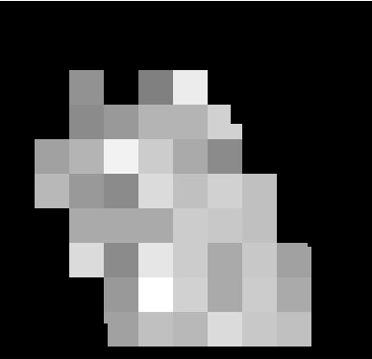
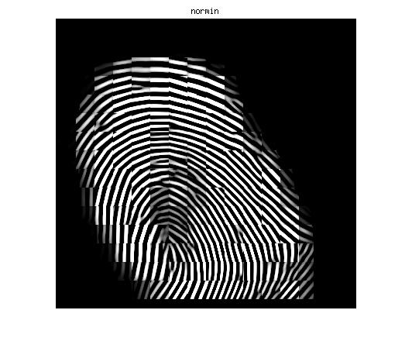
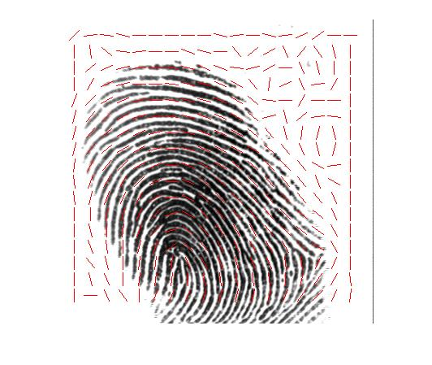
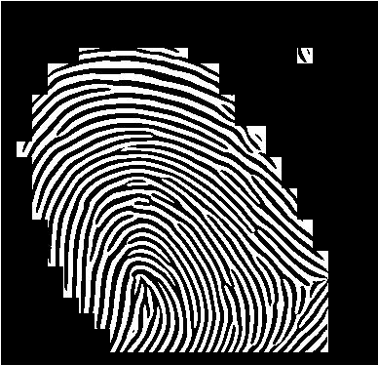
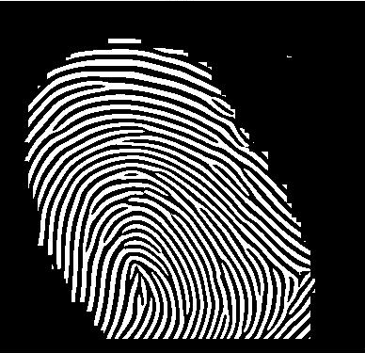
Initial fingerprint image
Segmentation
Normalization
Ridge Orientation
Thinning
Binarisation

Slide 7
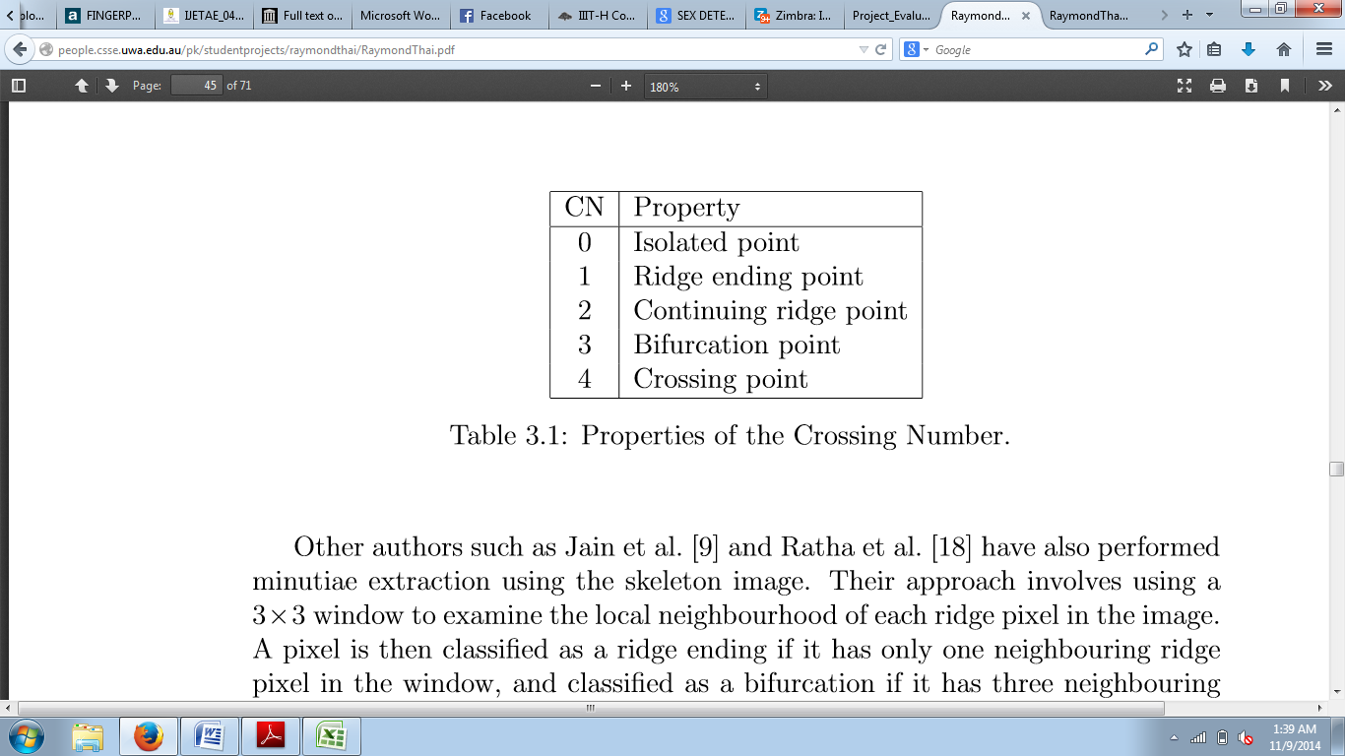
Project flow – minutiae extraction
Crossing Number(CN) Concept - The local neighbourhood of each ridge pixel is scanned using a 3X3 window and CN value is computed, which is half the sum of the differences between pairs of adjacent pixels in the eight-neighbourhood.

Slide 8
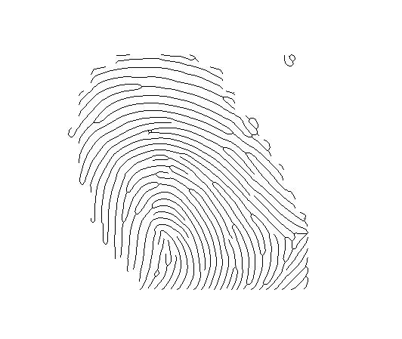
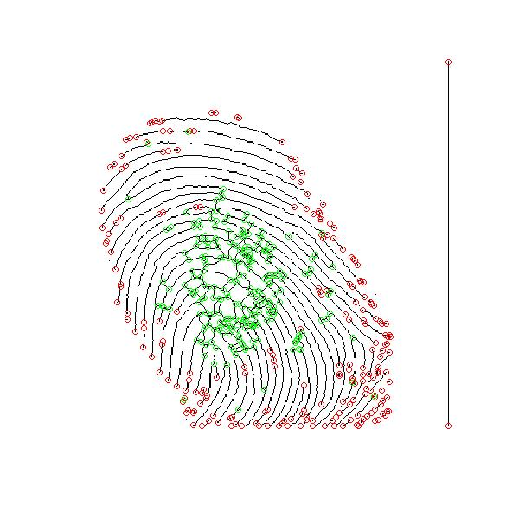
Skeletonised image
Extracted Minutiae

Slide 9
Project flow – post processing
Post processing of the images involves removal of false minutiae that are identified.
Region of Interest – Only those minutiae are considered that lie within our region of interest.
Suppression of false minutiae - A minimum distance threshold that needs to be there between two valid minutiae.

Slide 10
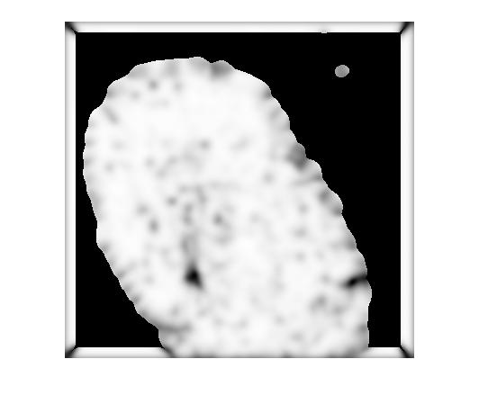
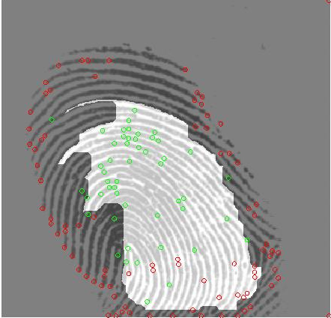
Region of Interest defined
False minutiae suppressed

Slide 11
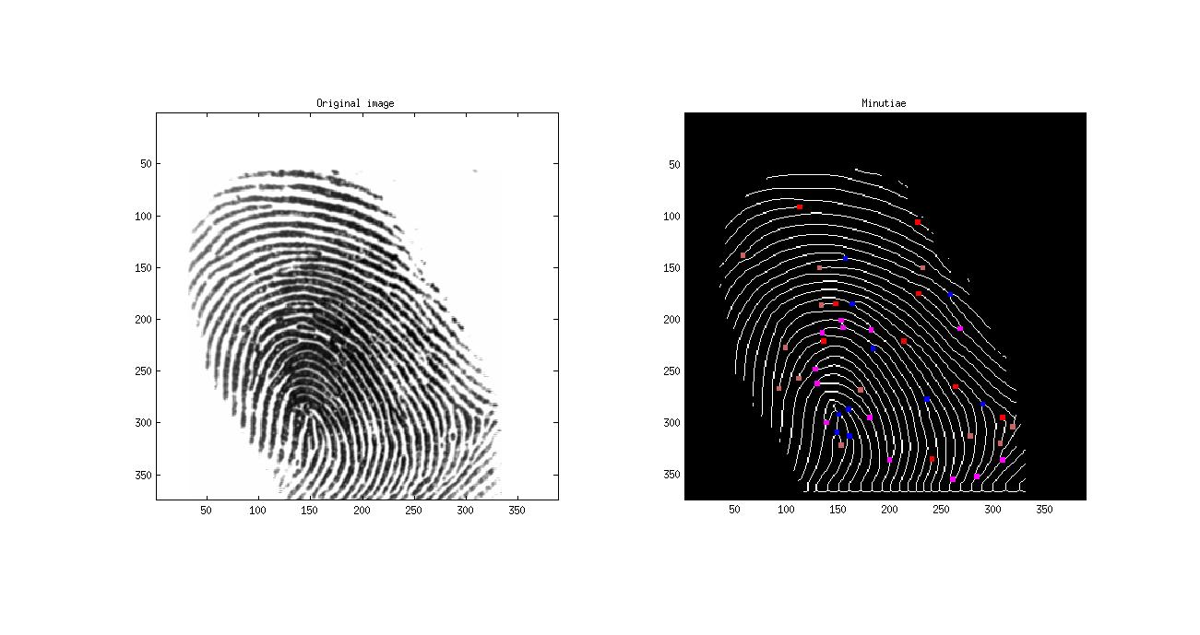
final output of enhancement
Initial query Image
Enhanced image

Slide 12
Features used
The features that we are taking into consideration are:
(i) x coordinate of minutiae
(ii) y coordinate of minutiae
(iii) Crossing number as calculated for the minutiae
(iv) Orientation of minutiae in radians
(v) Reference orientation of the image

Slide 13
Minutiae matching
The feature vector of the query image and the image from the database are compared.
If the fingerprint images are not oriented in the same way, align them by applying transformation using rotation matrix.
Threshold for the Euclidean distance between two minutiae is defined as 15 and that for the difference in their orientation angle is defined as 14.
Similarity index = √(n²/(Count1*Count2))
Threshold determined by:
(i) FMR(False Match Rate)-genuine classified as actual impostor comparison
(ii) FNMR(False non-Match Rate)-impostor classified as an actual genuine comparison

Slide 14
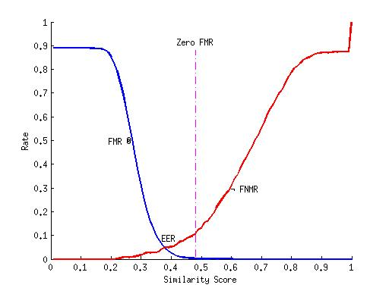
Accuracy plot

Slide 15
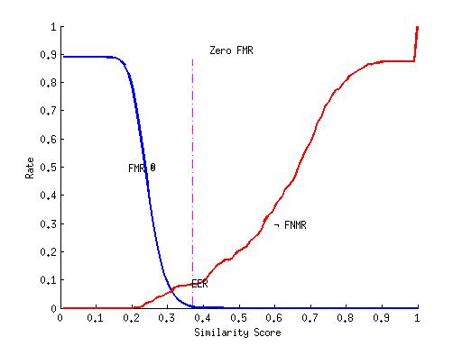
Accuracy plot

Slide 16
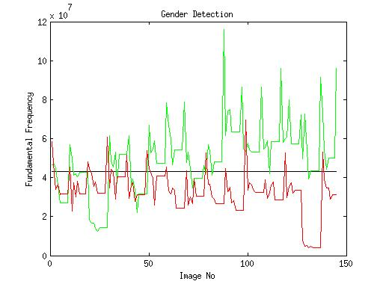
Gender recognition
FFT of each image is taken and the fundamental frequency is used to calculate the threshold
Green – male, Red - female
Accuracy
Male fingerprints - 75.1724%
Female fingerprints - 86.8966%

Slide 17
Literature considered
Fingerprint image enhancement : Algorithm and performance evaluation, Hong, L., Wan, Y., and Jain, A. K.(IEEE Transactions on Pattern Analysis and Machine Intelligence 1998)
An Intelligent Automatic Fingerprint Recognition System Design, Necla ÖZKAYA, Şeref SAĞIROĞLU, Arif WANI(International Conference on Machine Learning and Applications, 2006)
Fingerprint Recognition Using Artificial Neural Network, Tripti Rani Borah, Kandarpa Kumar Sarma & Pran Hari Talukdar(International Journal of Electronics Signals and Systems, 2013)
A Study on Various Methods of Gender Identification Based on Fingerprints, Ms. Ritu Kaur, Mrs. Susmita Ghosh Mazumdar, Mr. Devanand Bhonsle(International Journal of Emerging Technology and Advanced Engineering, 2012)
Sex Determination From Fingerprint, R. A. Tadross, A. M. Badawi, M. R. Mahfouz, R. L. Jantz, C. M. Blair(Cairo International Biomedical Engineering Conference, 2006) 6) Fingerprint Based Gender Identification Using Frequency Domain Analysis, Ritu Kaur and Susmita Ghosh Mazumdar(International Journal of Advances in Engineering & Technology, 2012)
Fingerprint Image Enhancement and Minutiae Extraction, Raymond Thai(School of Computer Science and Software Engineering, The University of Western Australia, 2003)

Slide 18
Thank you!

